Slide 1
Clustering Validation & Assessment
Prof. Navneet Goyal
Material taken from text book (chapter 8) and from DMA book by Zaki & Meira (chapter 17)

Slide 2
Cluster Validity
“The validation of clustering structures is the most difficult and frustrating part of cluster analysis.
Without a strong effort in this direction, cluster analysis will remain a black art accessible only to those true believers who have experience and great courage.”
Algorithms for Clustering Data, Jain and Dubes

Slide 3
Cluster Validity
For supervised classification we have a variety of measures to evaluate how good our model is
Accuracy, precision, recall etc…
For cluster analysis, the analogous question is how to evaluate the “goodness” of the resulting clusters?
But “clusters are in the eye of the beholder”!
Then why do we want to evaluate them?
To avoid finding patterns in noise
To compare clustering algorithms
To compare two sets of clusters
To compare two clusters

Slide 4
Introduction
Objective approaches to assess clustering results
Clustering validation and assessment:
Clustering evaluation (goodness or quality))
Clustering stability (sensitivity to parameters)
Clustering tendency (suitability of applying clustering)
Validity metrics
External (prior or expert specified. For eg. Label for each point): criteria not inherent to the dataset
Internal (intra & inter cluster distances): criteria that are derived from the data itself
Relative (direct comparison of different clustering obtained by different parameters of the same algo.)

Slide 5
Introduction
Remember SSE for Bisecting K-means?
What about using SSE for density-based clusters?
Clustering validation & assessment should be part of any cluster analysis

Slide 6
Clusters found in Random Data
Random Points
DBSCAN
K-means
Complete Link

Slide 7
Introduction
Clusters do not look compelling for any of the three methods
In higher dimensions, such problems can not be easily detected

Slide 8
Different Aspects of Cluster Validation
Determining the clustering tendency of a set of data, i.e., distinguishing whether non-random structure actually exists in the data.
Comparing the results of a cluster analysis to externally known results, e.g., to externally given class labels.
Evaluating how well the results of a cluster analysis fit the data without reference to external information.
- Use only the data
Comparing the results of two different sets of cluster analyses to determine which is better.
Determining the ‘correct’ number of clusters.
For 2, 3, and 4, we can further distinguish whether we want to evaluate the entire clustering or just individual clusters.

Slide 9
Measures of Cluster Validity
Numerical measures that are applied to judge various aspects of cluster validity, are classified into the following three types.
External Index: Used to measure the extent to which cluster labels match externally supplied class labels.
Entropy
Internal Index: Used to measure the goodness of a clustering structure without respect to external information.
Sum of Squared Error (SSE)
Relative Index: Used to compare two different clusterings or clusters.
Often an external or internal index is used for this function, e.g., SSE or entropy
Sometimes these are referred to as criteria instead of indices
However, sometimes criterion is the general strategy and index is the numerical measure that implements the criterion.

Slide 10
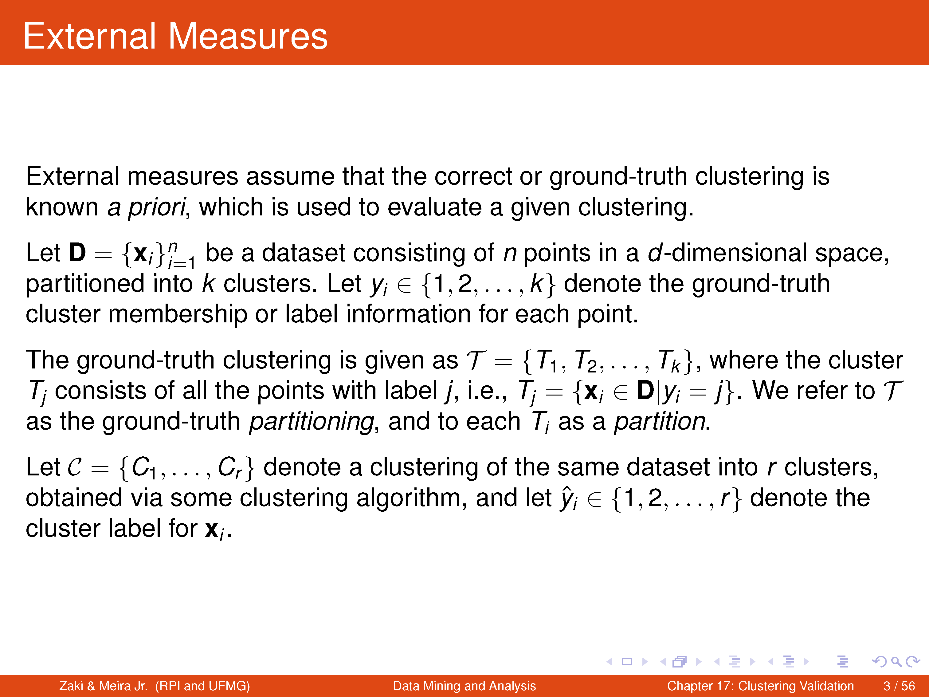

Slide 11
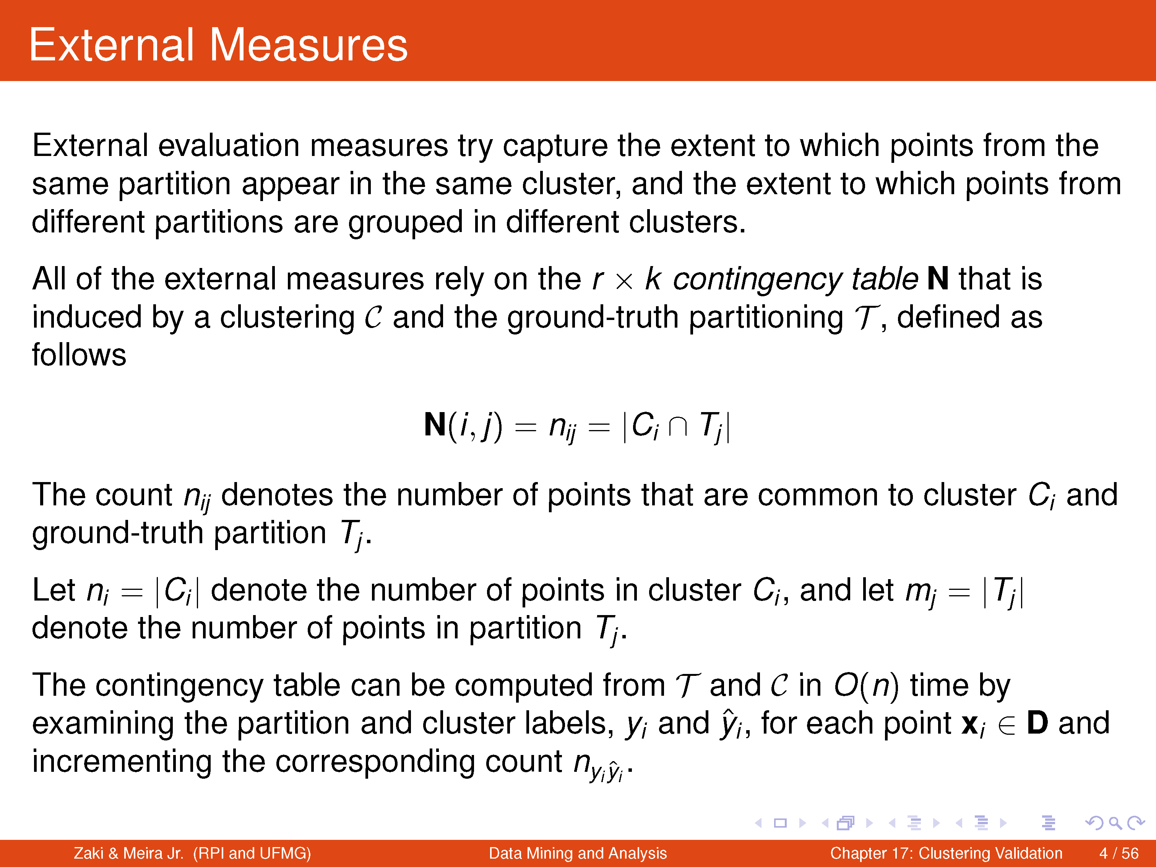

Slide 12
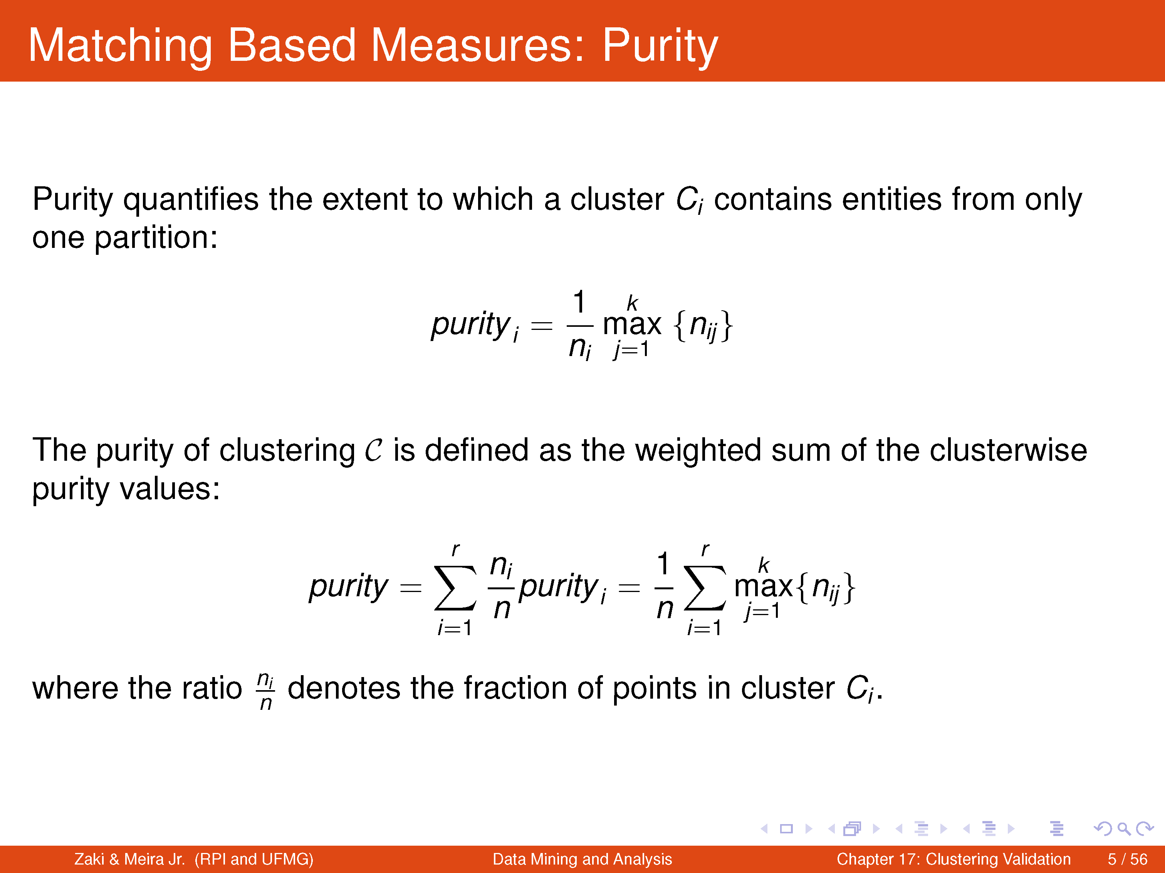
Larger the purity of C, the better the agreement with the ground truth
Max. value of purity is 1.

Slide 13
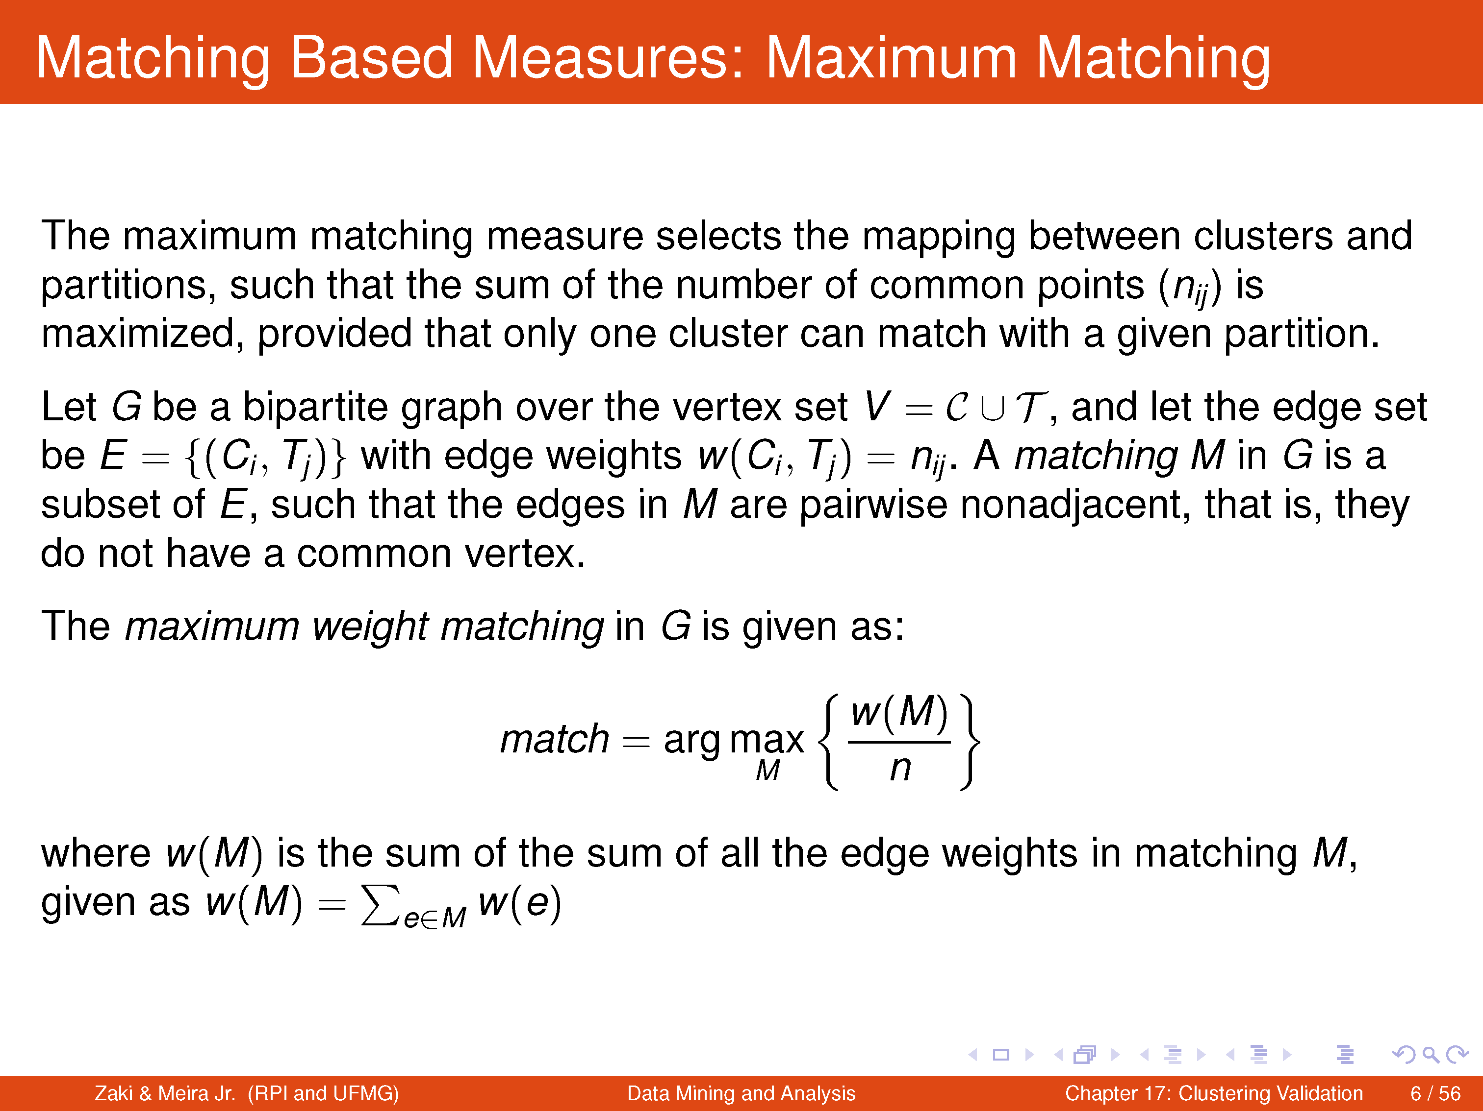

Slide 14
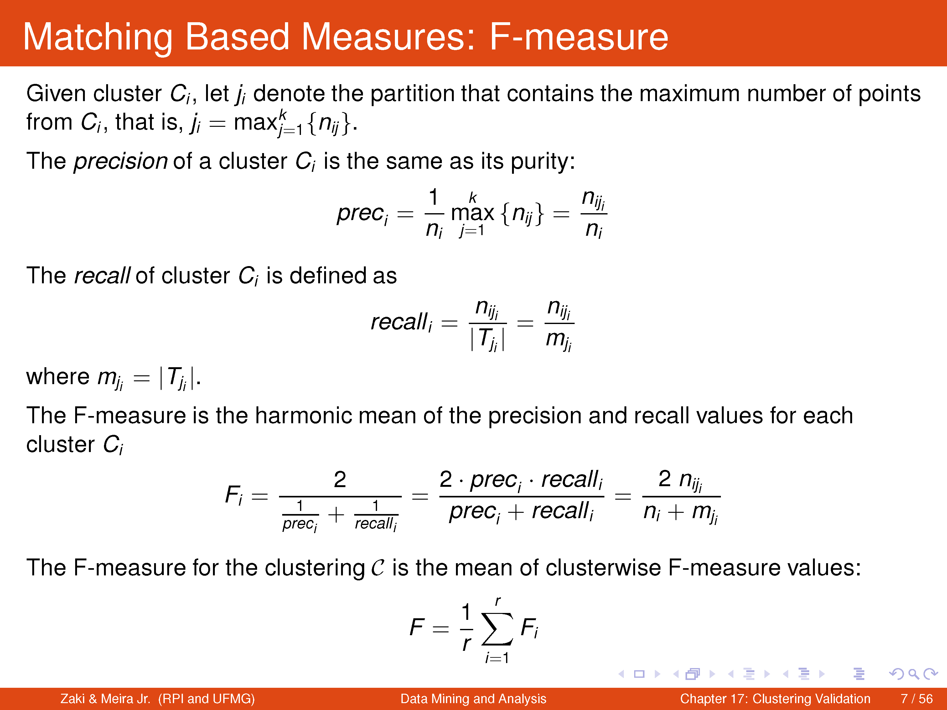

Slide 15
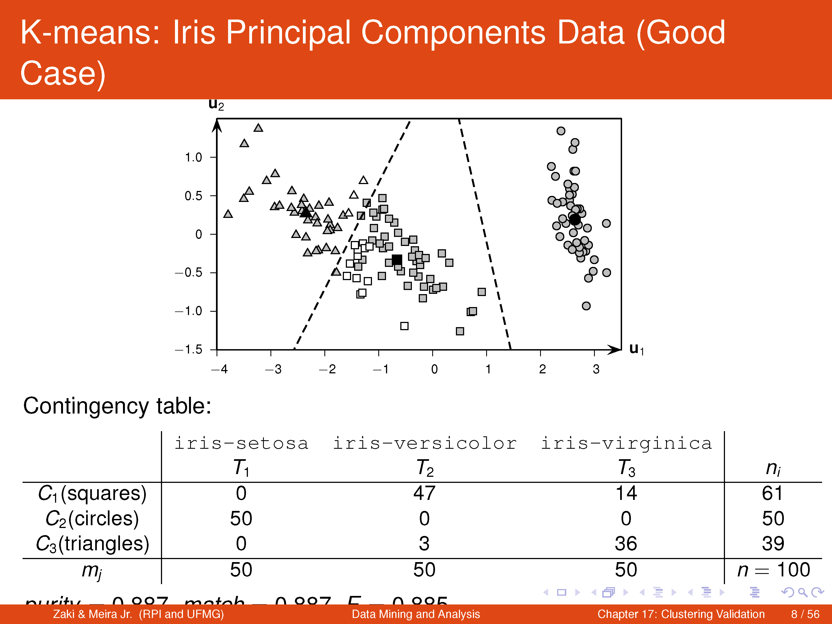

Slide 16
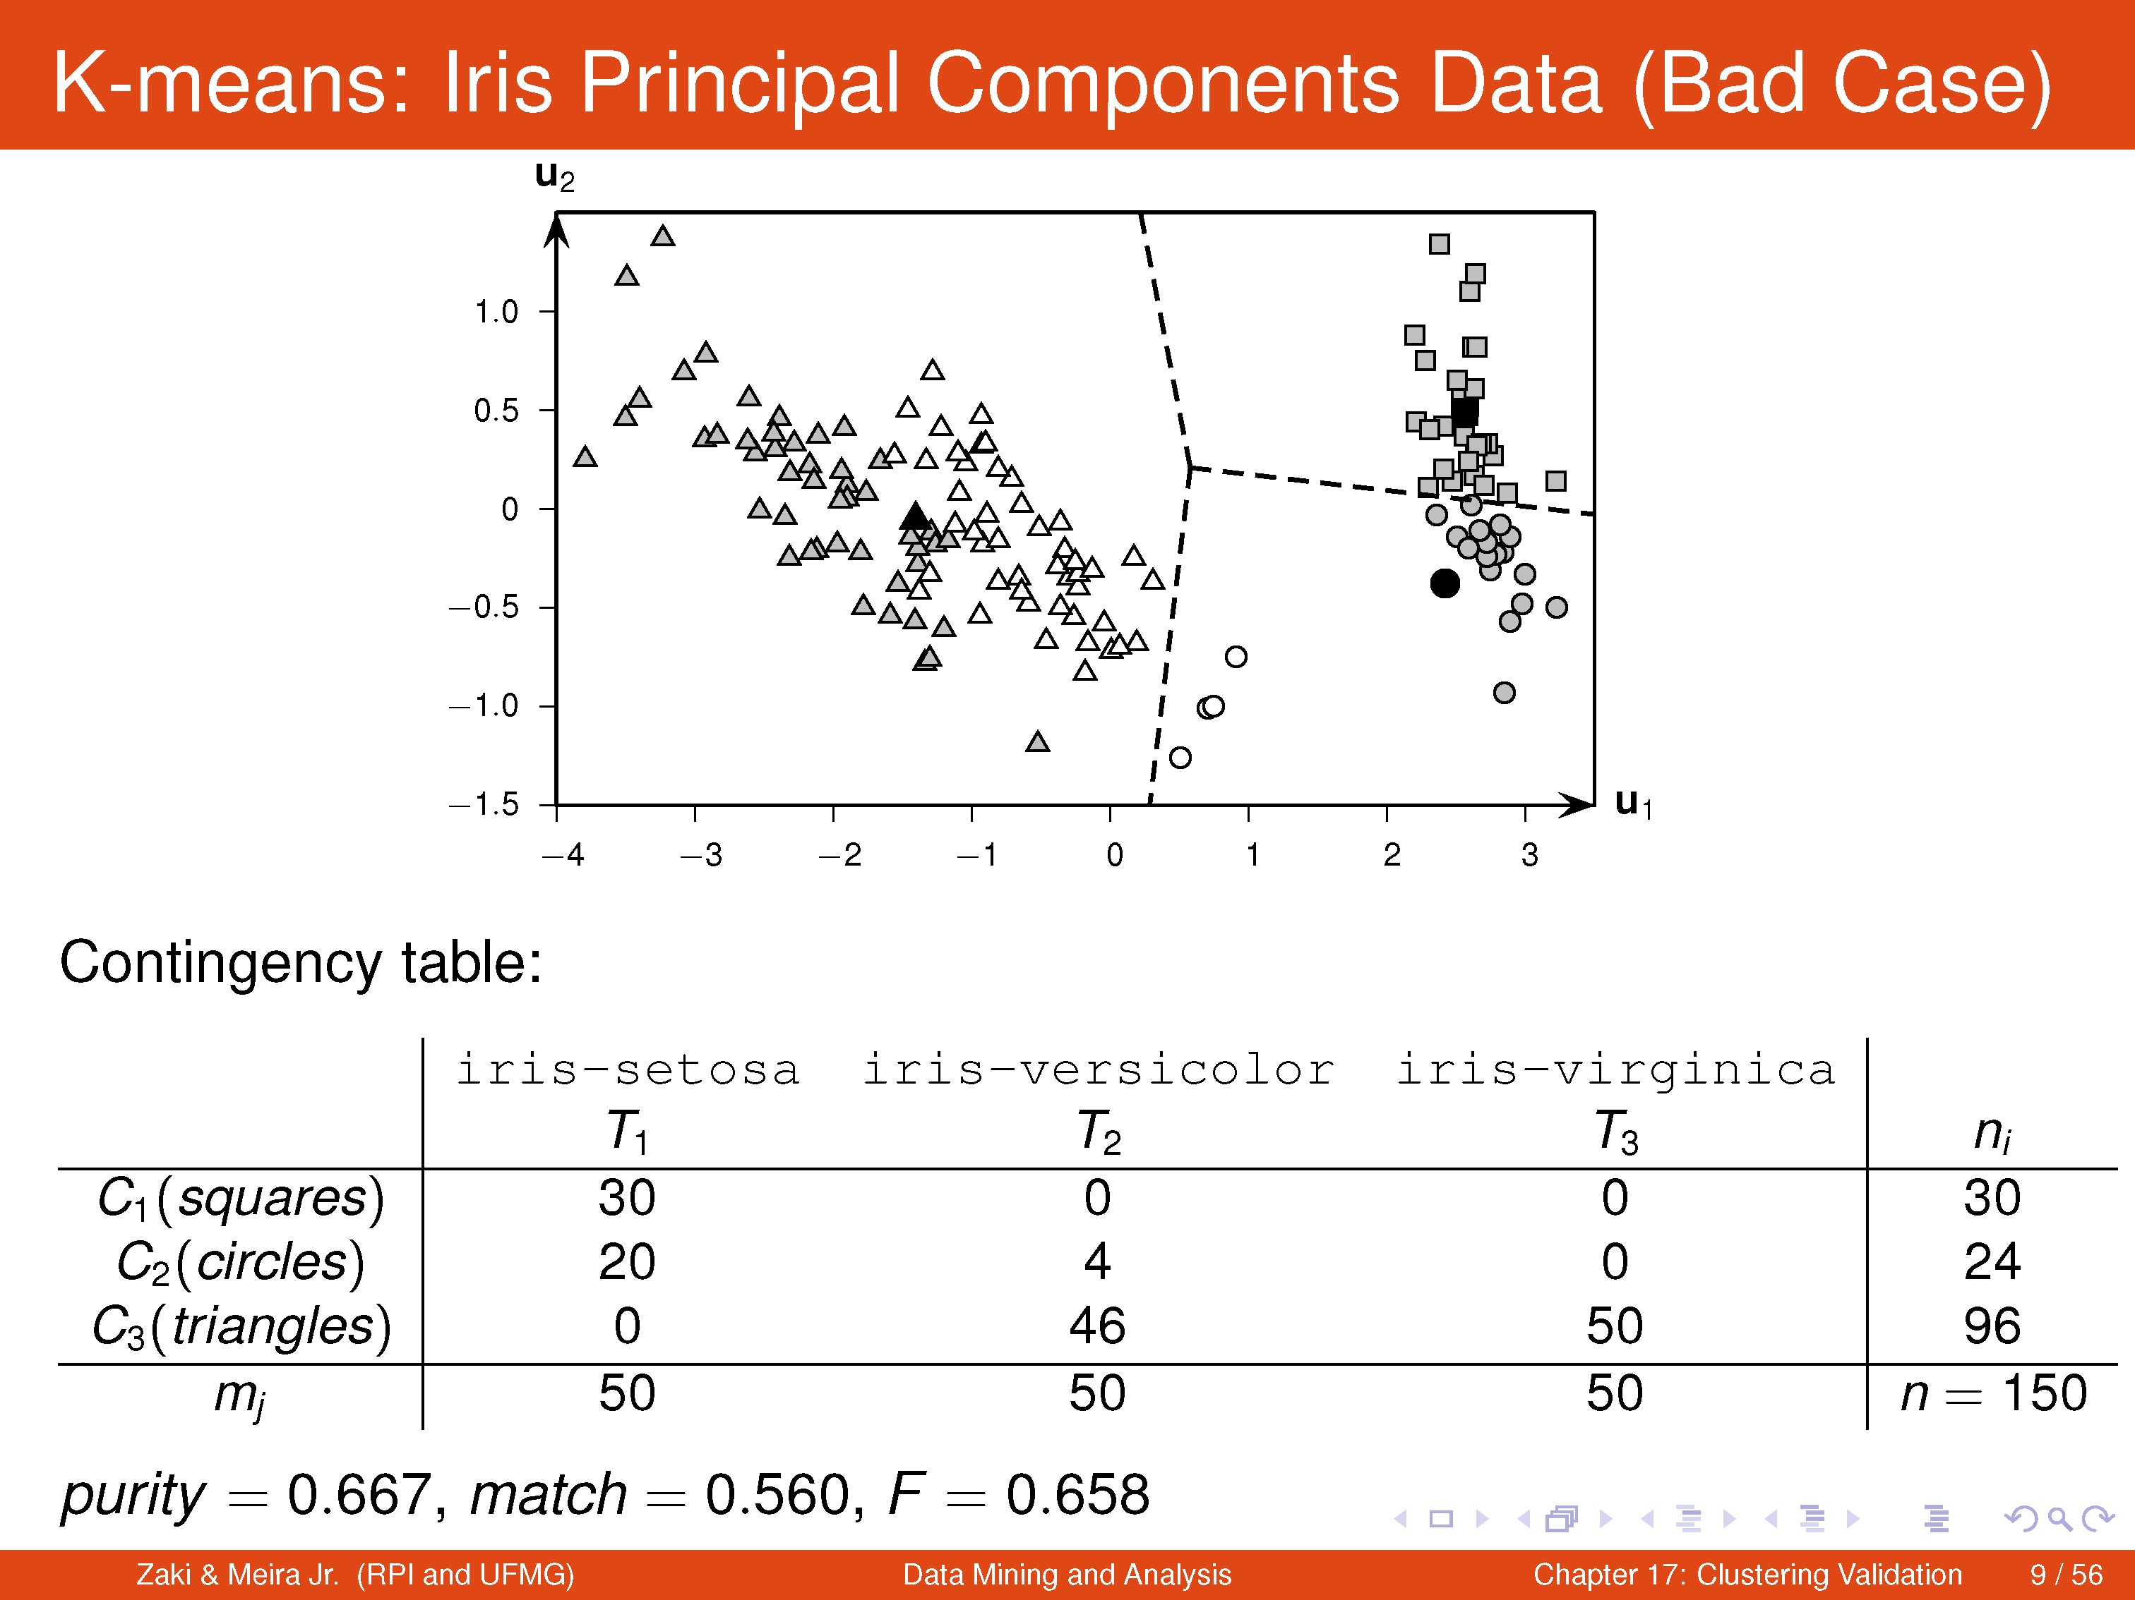

Slide 17
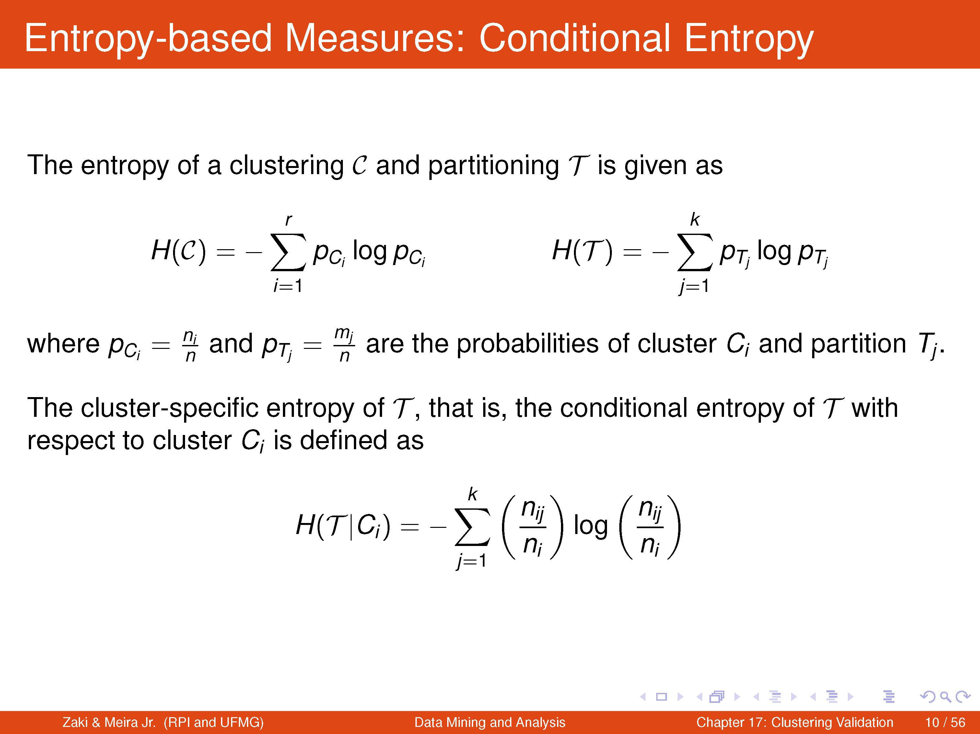

Slide 18
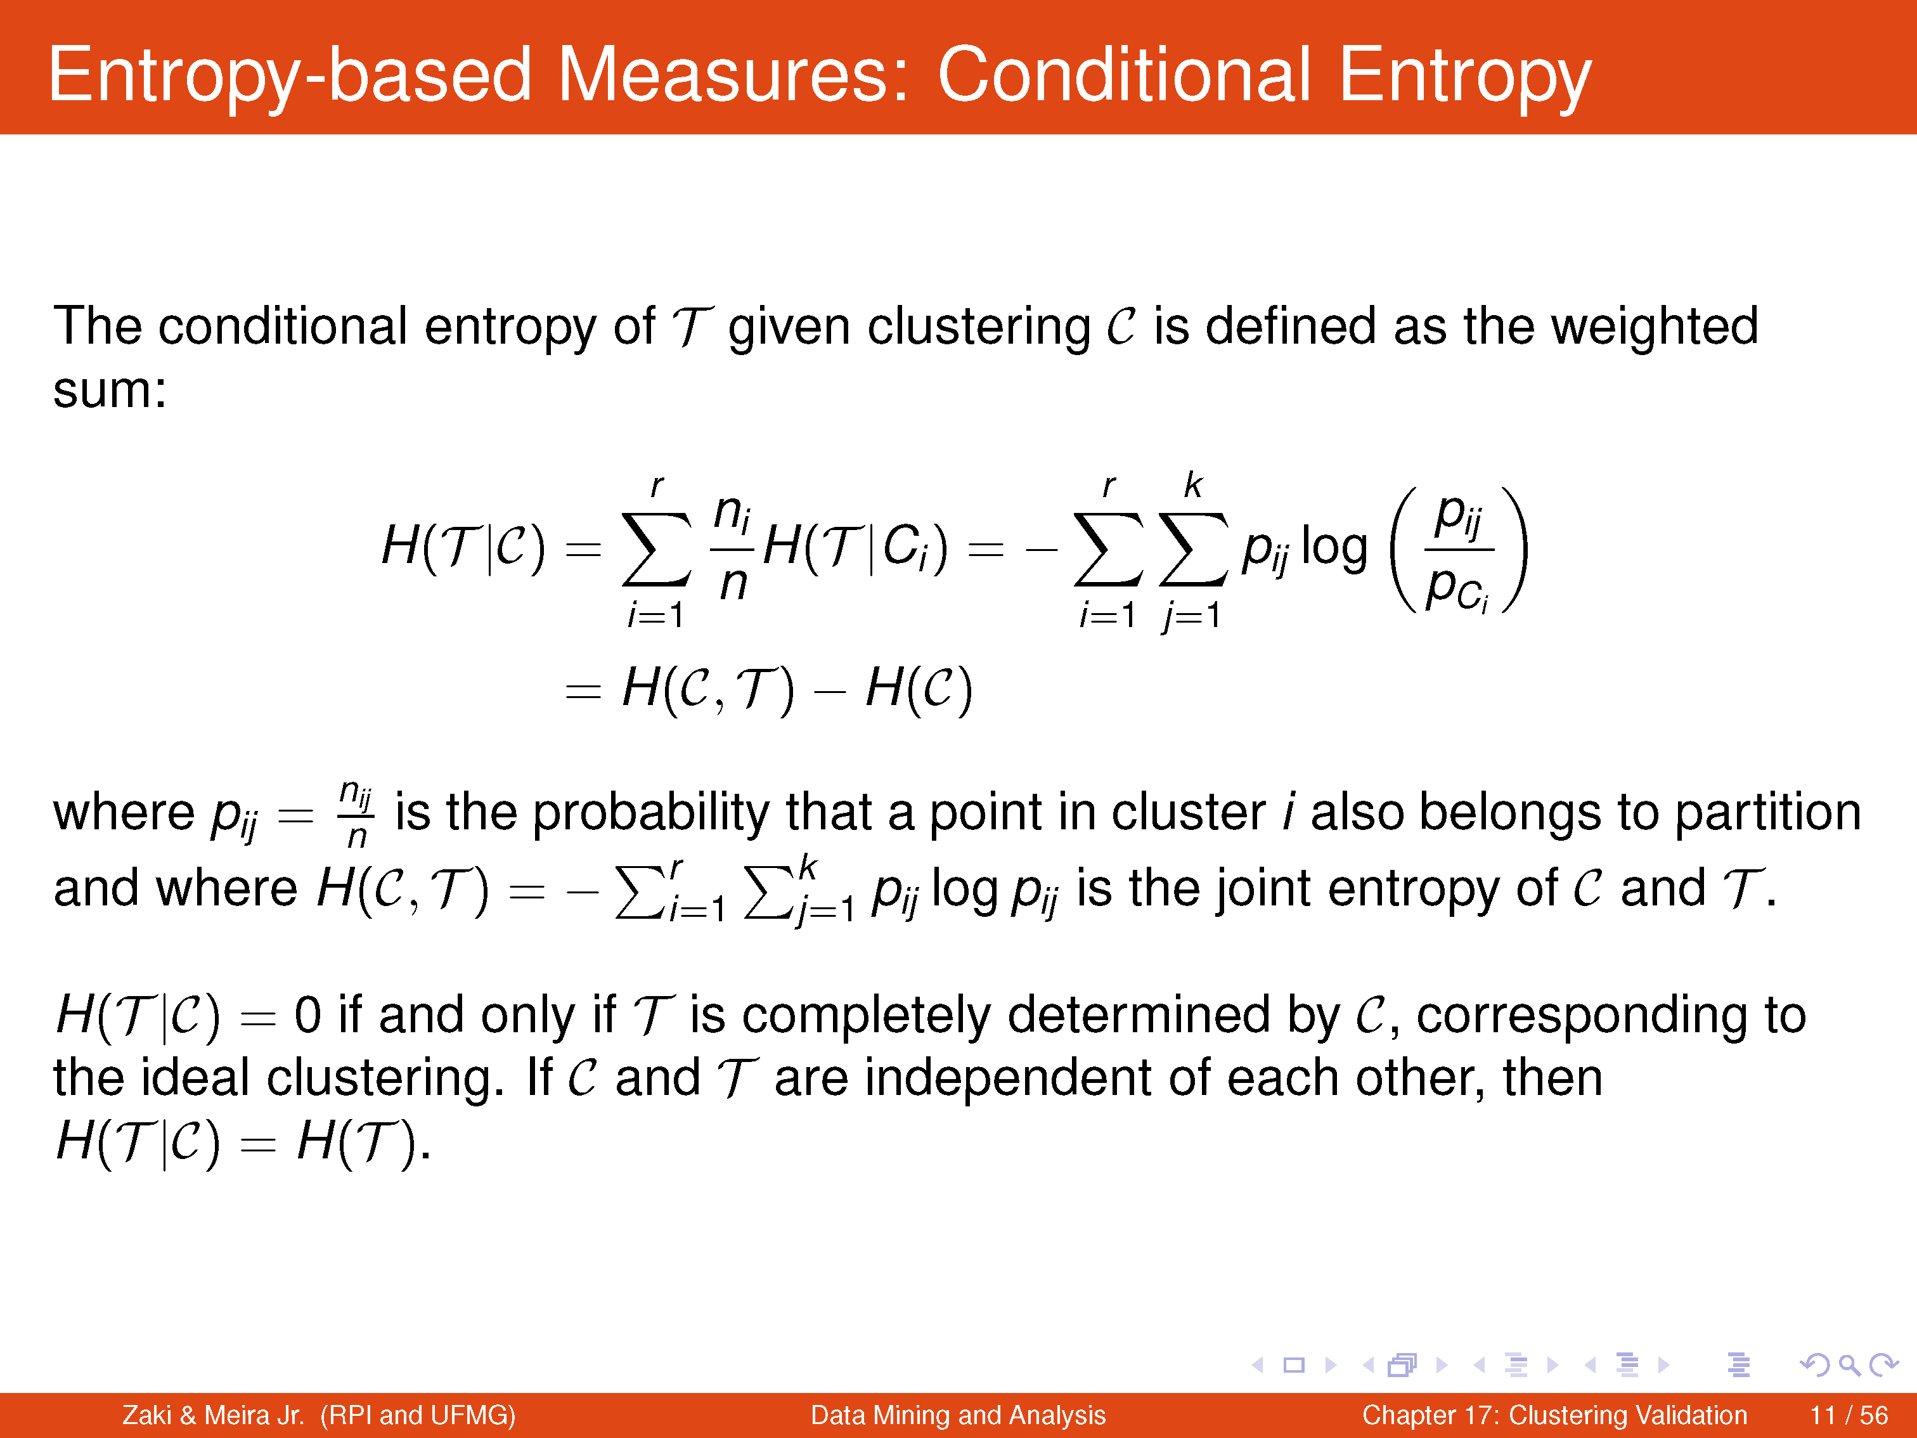

Slide 19
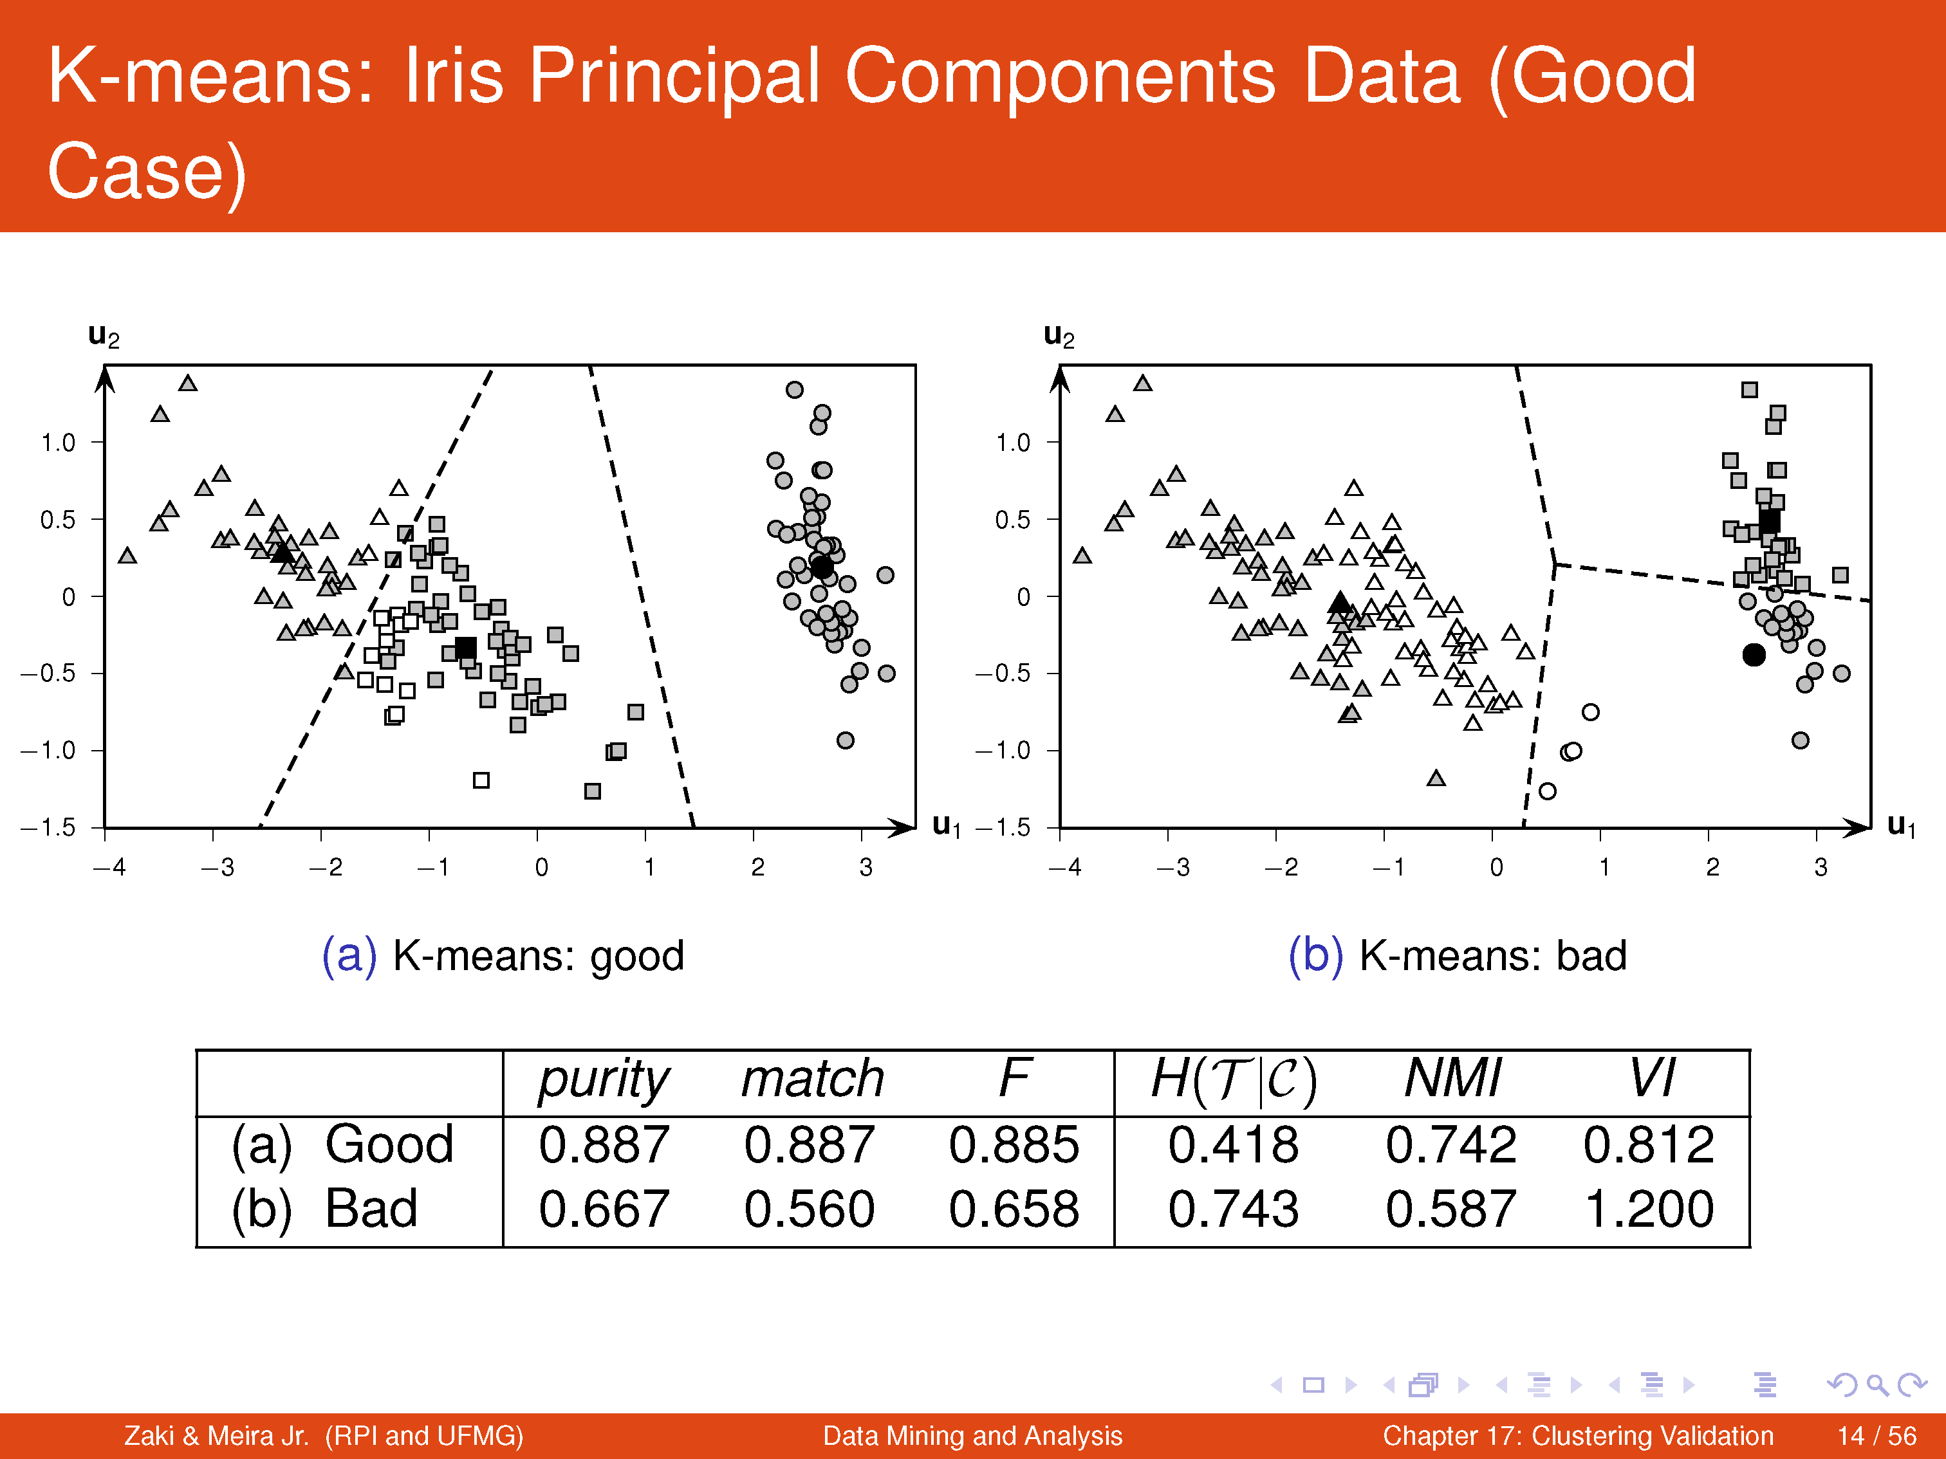

Slide 20
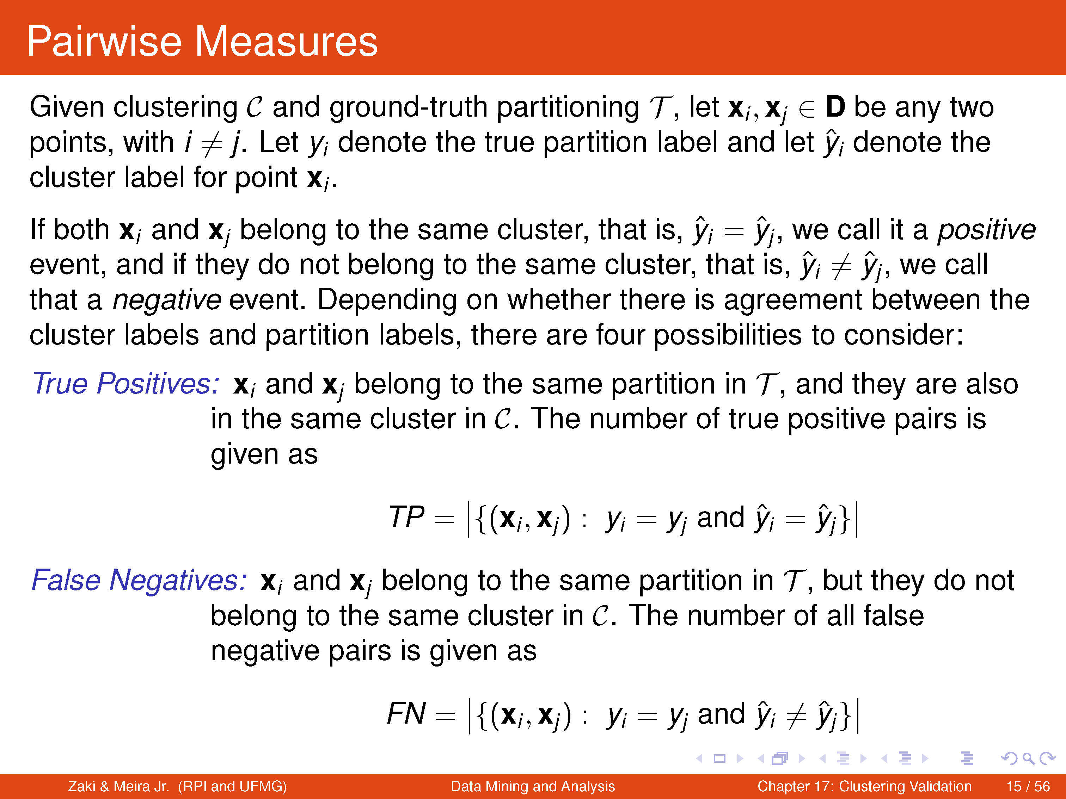

Slide 21
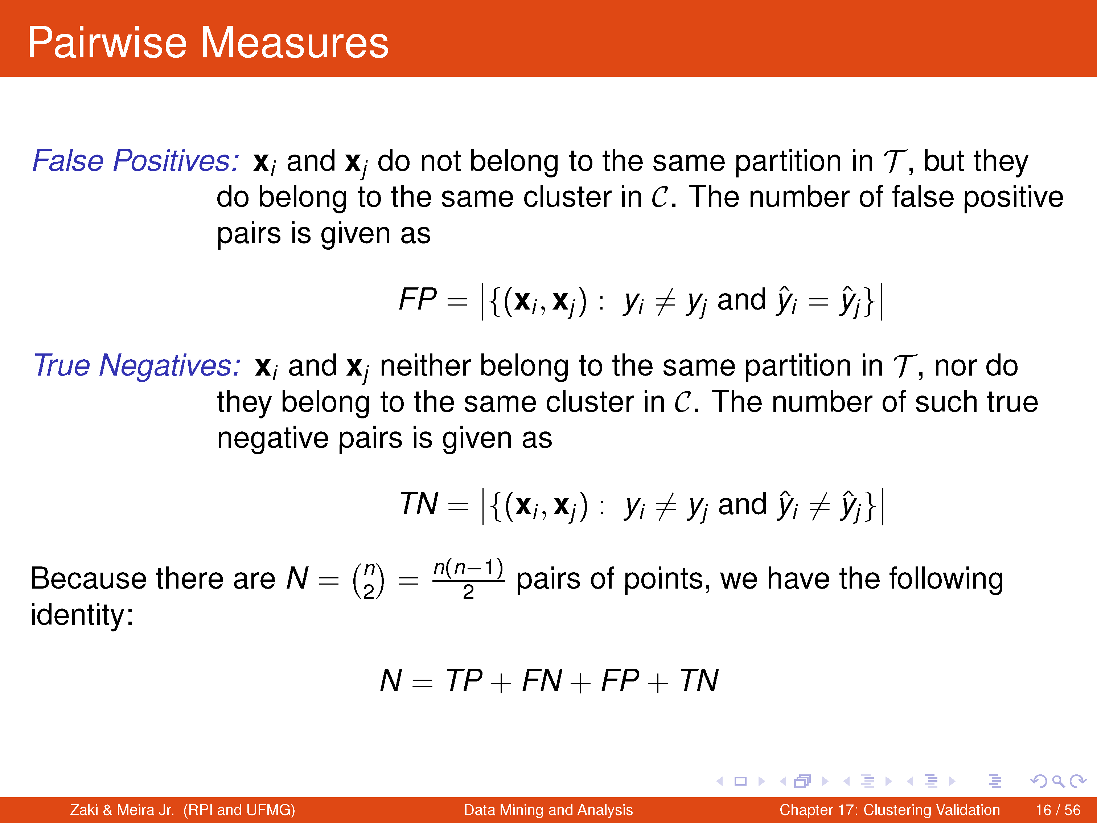

Slide 22
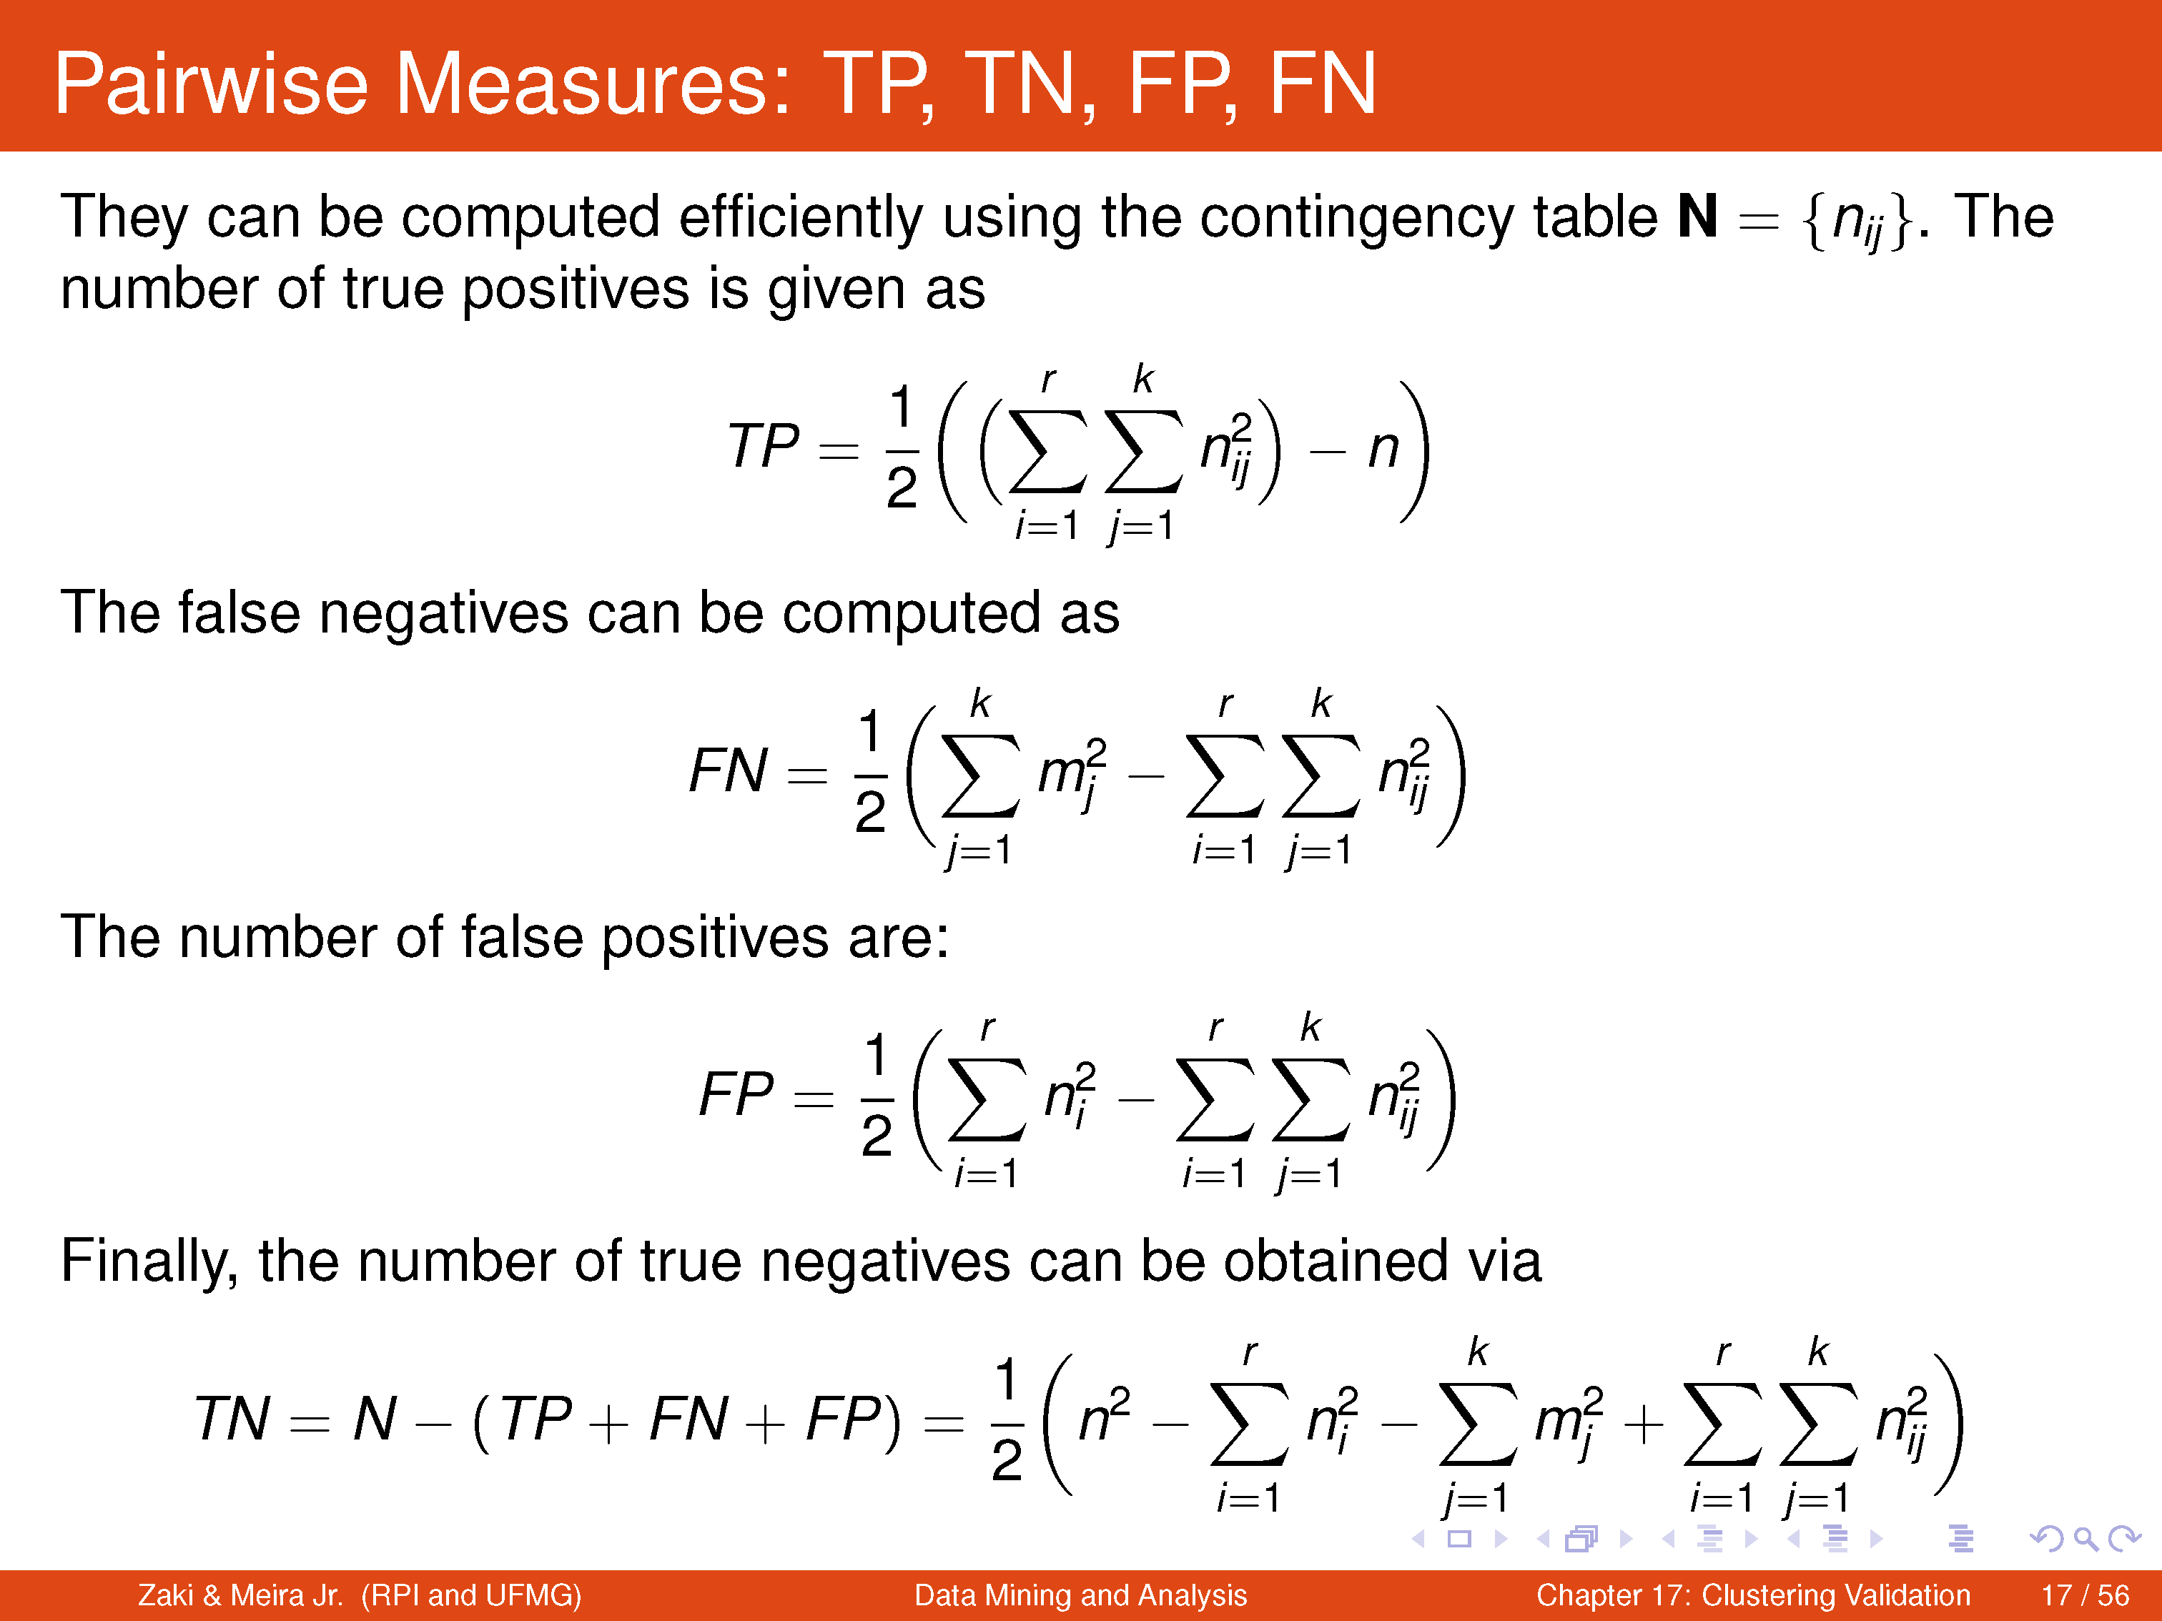

Slide 23
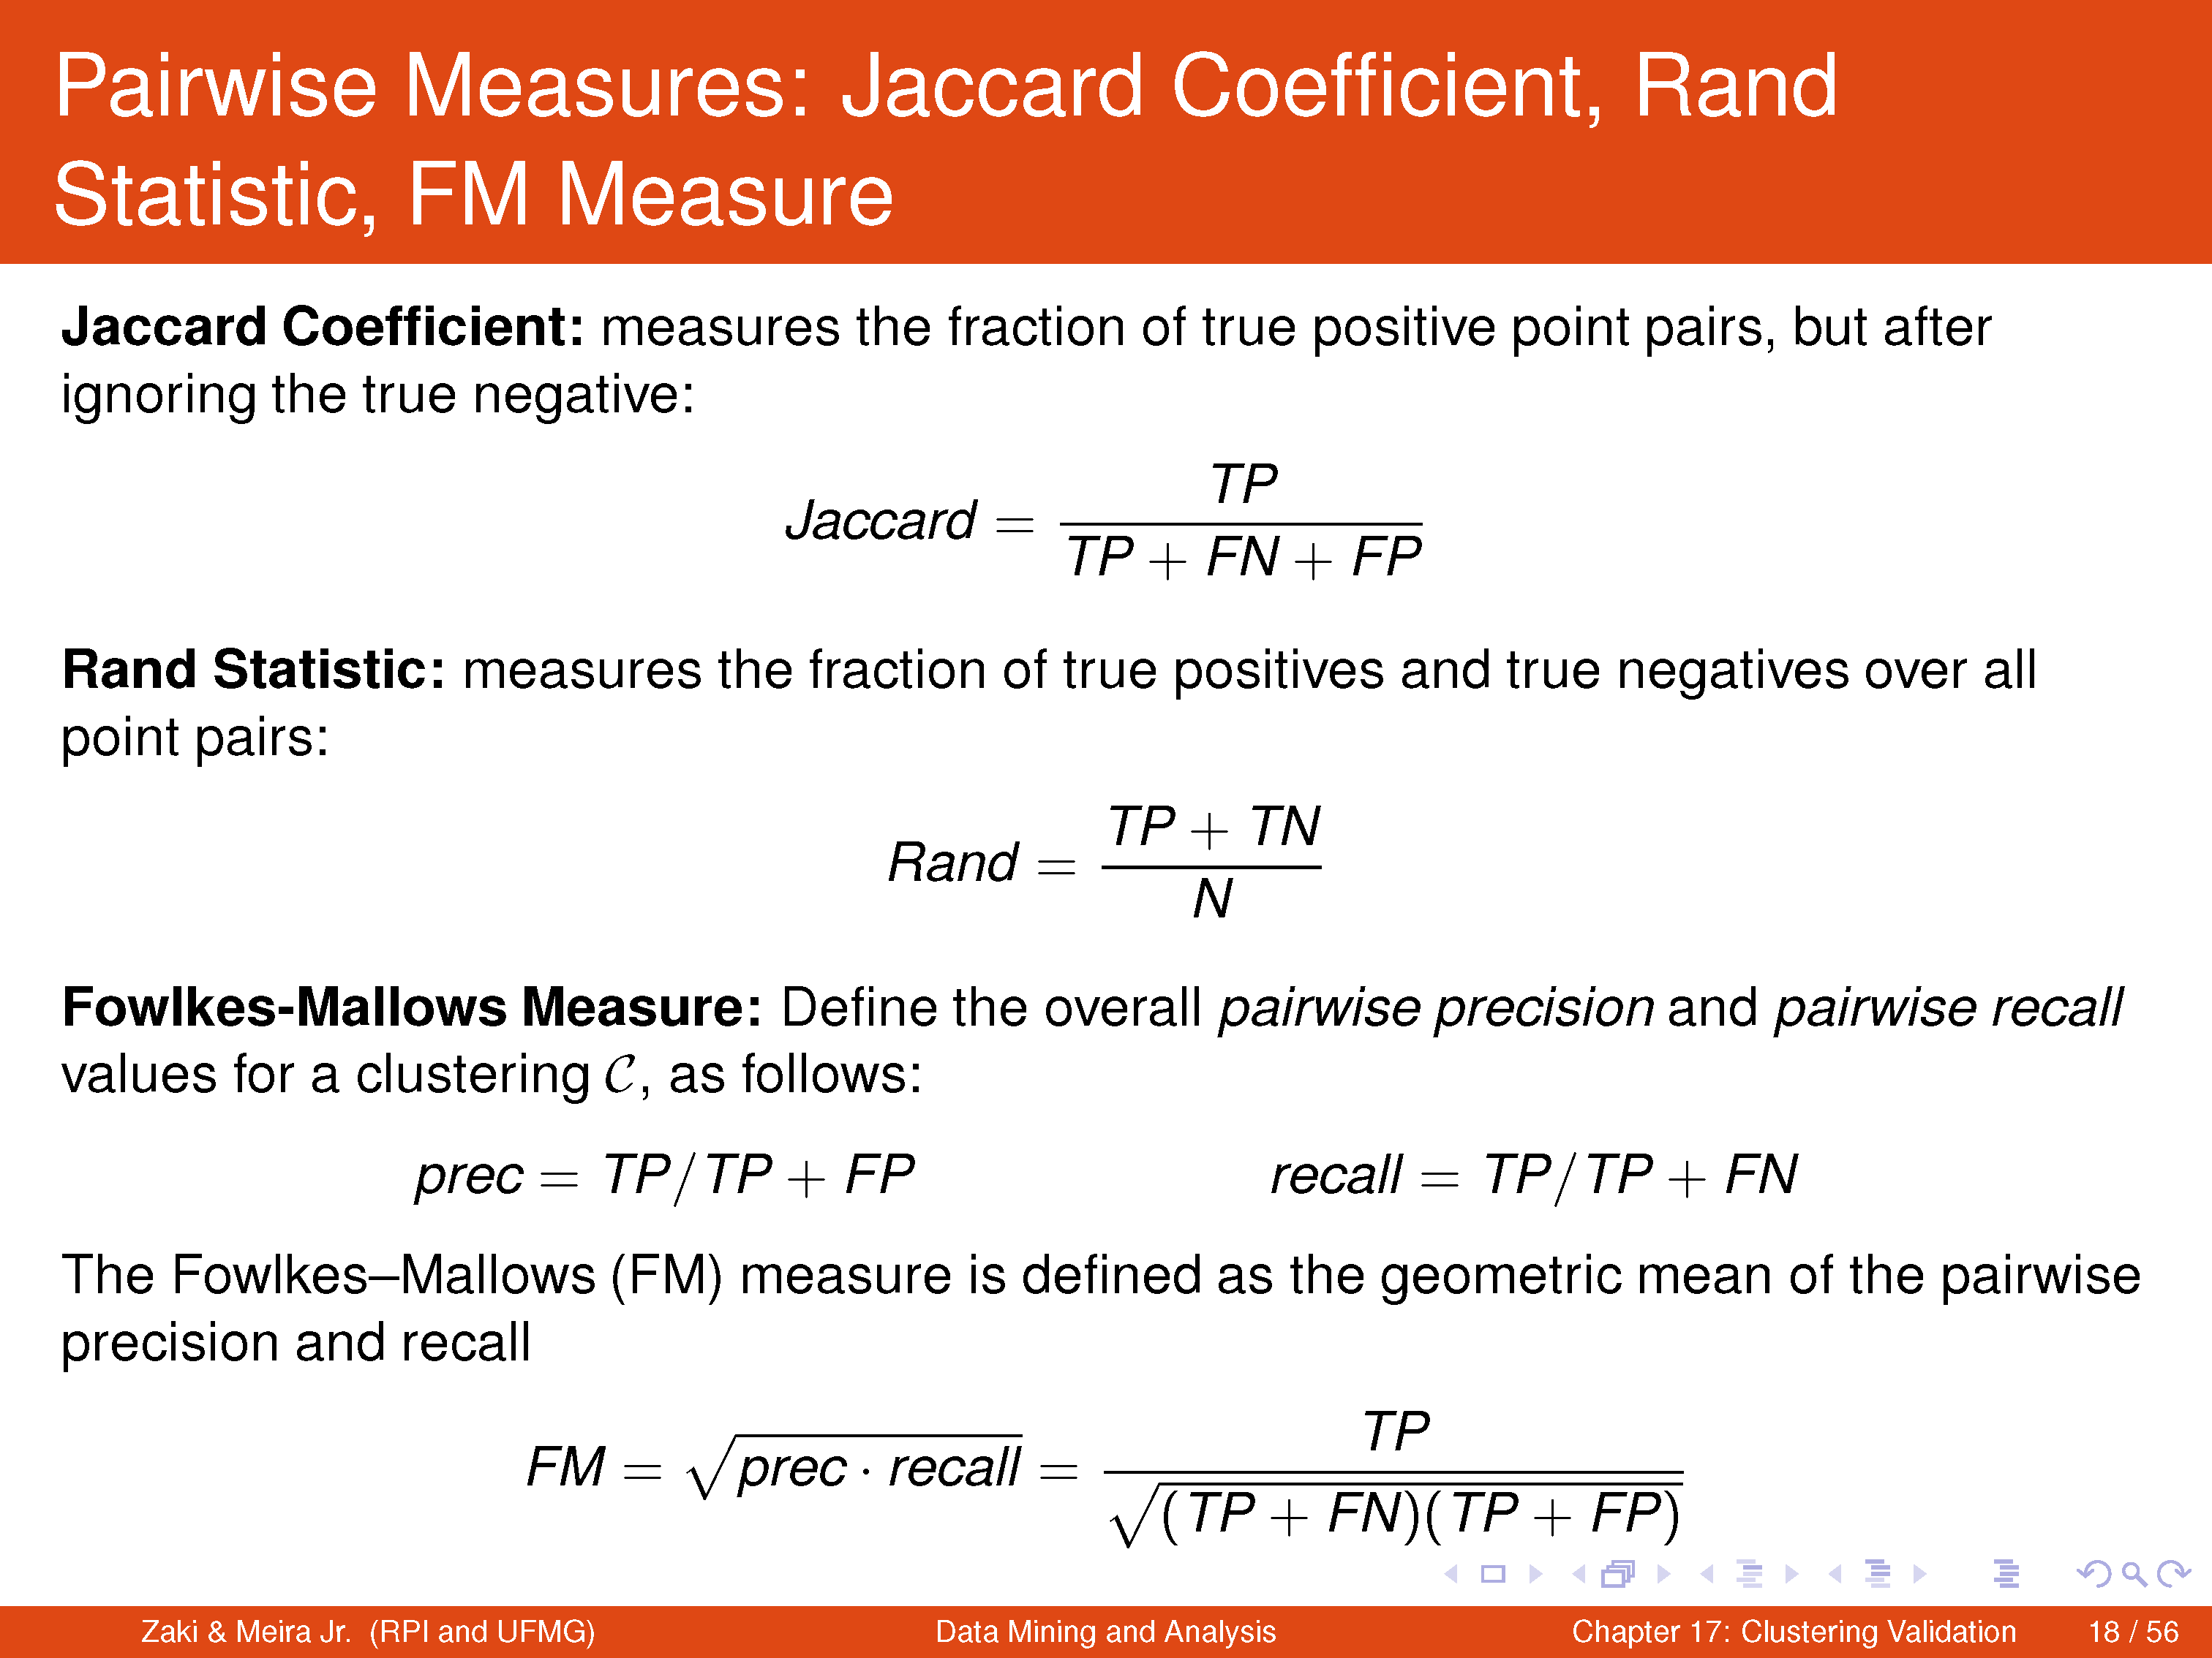

Slide 24
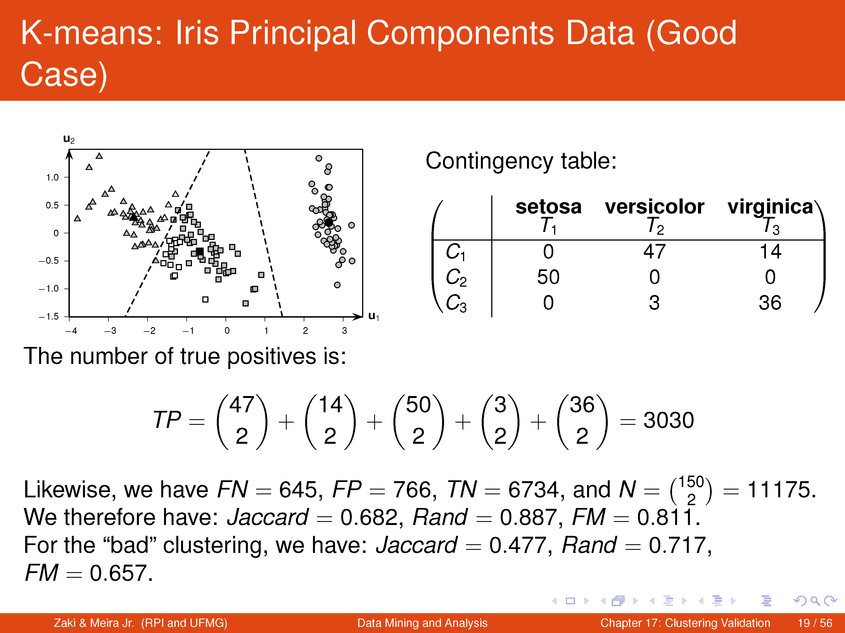

Slide 25
Internal Measures
No access to ground-truth partitioning
Typical scenario when clustering a dataset
Internal measures utilize the following notions to evaluate cluster quality:
Intracluster similarity or compactness
Intercluster separation
Based on distance or proximity matrix

